Slide 1
Chapter 4 Mathematical Functions, Characters, and Strings

Slide 2
Objectives
To solve mathematics problems by using the methods in the Math class.
To represent characters using the char type.
To represent strings using the String objects.
To format output

Slide 3
The Math Class
Java provides many useful methods and two constants in the Math class for performing common mathematical functions.
Class constants:
  PI
  E (the base of natural logarithms)
Class methods:
  Trigonometric Methods
  Exponent Methods
  Rounding Methods
  min, max, abs, and random Methods

Slide 4
Trigonometric Methods
sin(radians)
cos(radians)
tan(radians)
asin(a)
acos(a)
atan(a)
toRadians(degrees)
toDegrees(radians)
Examples:
Math.sin(0) returns 0.0
Math.cos(0) returns 1.0

Slide 5
Exponent Methods
exp(double a)
  Returns e raised to the power of a.
log(double a)
  Returns the natural logarithm of a.
log10(double a)
  Returns the 10-based logarithm of a.
pow(double a, double b)
  Returns a raised to the power of b.
sqrt(double a)
  Returns the square root of a.
Examples:
Math.exp(1) returns 2.71
Math.log(2.71) returns 1.0
Math.sqrt(4) returns 2.0
Math.pow(2, 3) returns 8.0
Math.pow(4, 0.5) returns 2.0
Math.pow(2.5, -2) returns 0.16

Slide 6
Rounding Methods
double ceil(double x)
  x rounded up to its nearest integer. This integer is returned as a double value.
double floor(double x)
  x is rounded down to its nearest integer. This integer is returned as a double value.
double rint(double x)
  x is rounded to its nearest integer. If x is equally close to two integers, the even one is returned as a double.
int round(float x)
  Return (int)Math.floor(x+0.5).
Math.ceil(2.1) returns 3.0
Math.ceil(-2.1) returns -2.0
Math.floor(2.1) returns 2.0
Math.floor(-2.1) returns -3.0
Math.rint(2.1) returns 2.0
Math.rint(-2.1) returns -2.0
Math.rint(2.5) returns 2.0
Math.rint(-2.5) returns -2.0
Math.round(2.6) returns 3
Math.round(-2.6) returns -3

Slide 7
min, max, and abs
max(a, b)and min(a, b)
  Returns the maximum or minimum of two parameters.
abs(a)
  Returns the absolute value of the parameter.
random()
  Returns a random double value
  in the range [0.0, 1.0).
Math.max(2, 3) returns 3
Math.max(2.5, 3) returns 3.0
Math.min(2.5, 3.6) returns 2.5
Math.abs(-2) returns 2
Math.abs(-2.1) returns 2.1
Math.random()

Slide 8

The random Method
Generates a random double value greater than or equal to 0.0 and less than 1.0 (0 <= Math.random() < 1.0).
Examples:
In general,

Slide 9
Character Data Type
All of the three statements below will store the character ‘A’ in letter.
char letter = ‘A’;
char letter = 65; //ASCII value
char letter = '\u0041'; //Unicode value

Slide 10
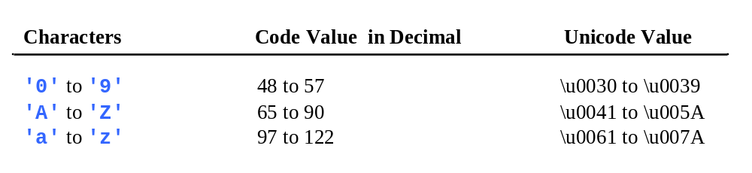
ASCII Code for Commonly Used Characters

Slide 11
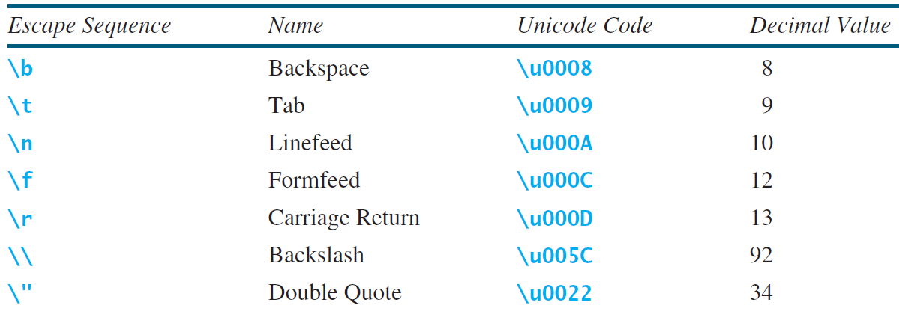
Escape Sequences for Special Characters
Backspace : ABCDFGHIJ
Formfeed : ABCDE_x000c_FGHIJ
Linefeed : ABCDE
FGHIJ
Single Quote : ABCDE'FGHIJ
Double Quote : ABCDE"FGHIJ
Backslash : ABCDE\FGHIJ
Horizontal Tab : ABCDE FGHIJ
FGHIJ
System.out.println("Backspace : " + "ABCDE\bFGHIJ");
System.out.println("Formfeed : " + "ABCDE\fFGHIJ");
System.out.println("Linefeed : " + "ABCDE\nFGHIJ");
System.out.println("Single Quote : " + "ABCDE\'FGHIJ");
System.out.println("Double Quote : " + "ABCDE\"FGHIJ");
System.out.println("Backslash : " + "ABCDE\\FGHIJ");
System.out.println("Horizontal Tab : " + "ABCDE\tFGHIJ");
System.out.println("Carriage Return: " + "ABCDE\rFGHIJ");

Slide 12
Casting between char and Numeric Types
int i = 'a'; // Same as int i = (int)'a';
char c = 97; // Same as char c = (char)97;

Slide 13
Comparing and Testing Characters
if (ch >= 'A' && ch <= 'Z')
System.out.println(ch + " is an uppercase letter");
else if (ch >= 'a' && ch <= 'z')
System.out.println(ch + " is a lowercase letter");
else if (ch >= '0' && ch <= '9')
System.out.println(ch + " is a numeric character");

Slide 14
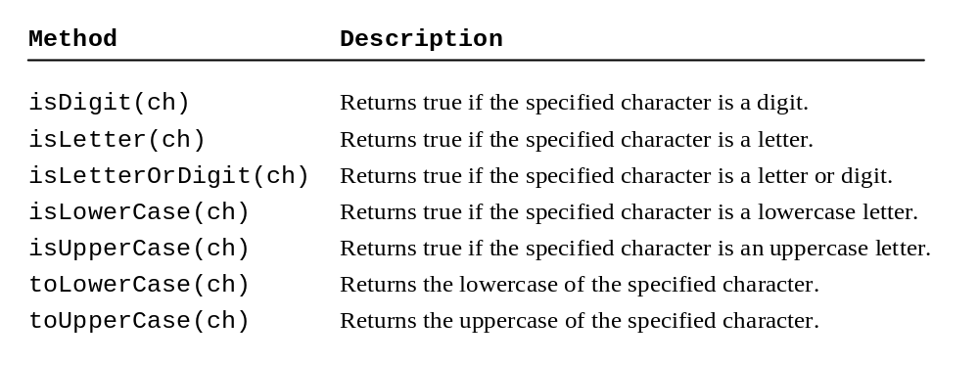
Methods in the Character Class
System.out.print(Character.isLetterOrDigit('h’)); //Displays true
System.out.print(Character.isLowerCase('h’)); //Displays true
System.out.print(Character.toUpperCase('h’)); //Displays H

Slide 15
The String Type
The char type only represents one character.
To represent a string of characters, use String which is a predefined class in the Java library .
For example,
String message = "Welcome to Java";

Slide 16
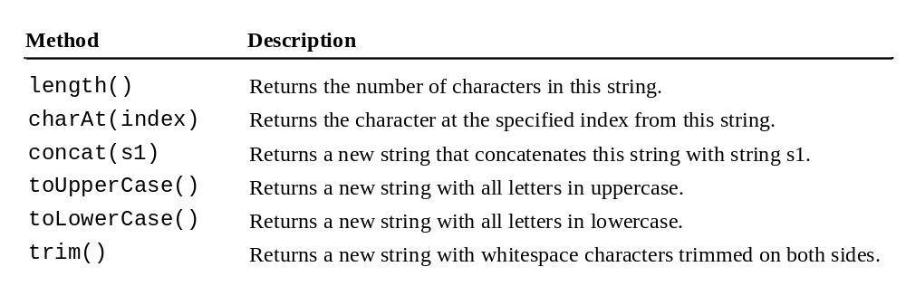
Simple Methods for String Objects
System.out.println(“hello”.length());
System.out.println(“hello”.charAt(1));
System.out.print(“Hello".toLowerCase());
System.out.println(“hello".toUpperCase());
System.out.print(“hello “.trim());

Slide 17
String Concatenation
String s3 = s1.concat(s2);
OR
String s3 = s1 + s2;
// Three strings are concatenated
String message = "Welcome " + "to " + "Java";
// String Chapter is concatenated with number 2
String s = "Chapter " + 2; // s becomes “Chapter 2”
// String Supplement is concatenated with character B
String s1 = "Supplement" + 'B'; // s1 becomes SupplementB

Slide 18
Instance Methods and Static Methods
Instance methods can only be invoked from a specific instance.
For example, string methods.
String s = “Hello”;
s.length();
A static method can be invoked without using an object.
All the methods defined in the Math class are static methods.
Math.sqrt(4.2);

Slide 19
Reading a String from the Console
The next() method reads a string that ends with a white space character.
The nextLine() method can be used to read an entire line.
Scanner input = new Scanner(System.in);
System.out.print("Enter three words separated by spaces: ");
String s1 = input.next();
String s2 = input.next();
String s3 = input.next();
System.out.println("s1 is " + s1);
System.out.println("s2 is " + s2);
System.out.println("s3 is " + s3);

Slide 20
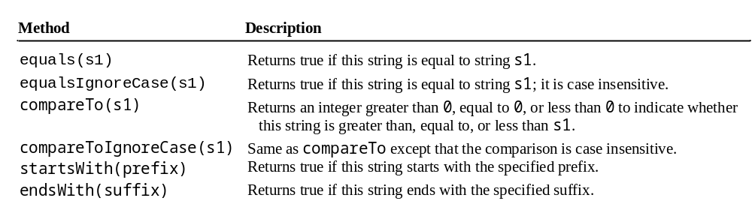
Comparing Strings
System.out.println("abc".equals("abcd")); //returns false System.out.println("abc".compareTo("abcd")); //returns -1
System.out.println("abc".startsWith("ab")); //returns true
OrderTwoCities
Run

Slide 21
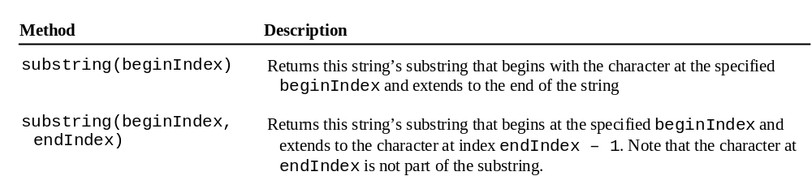
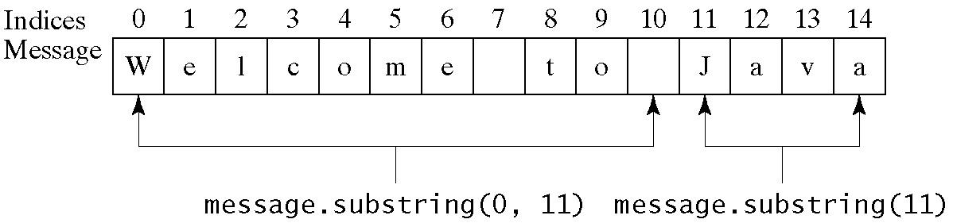
Obtaining Substrings

Slide 22
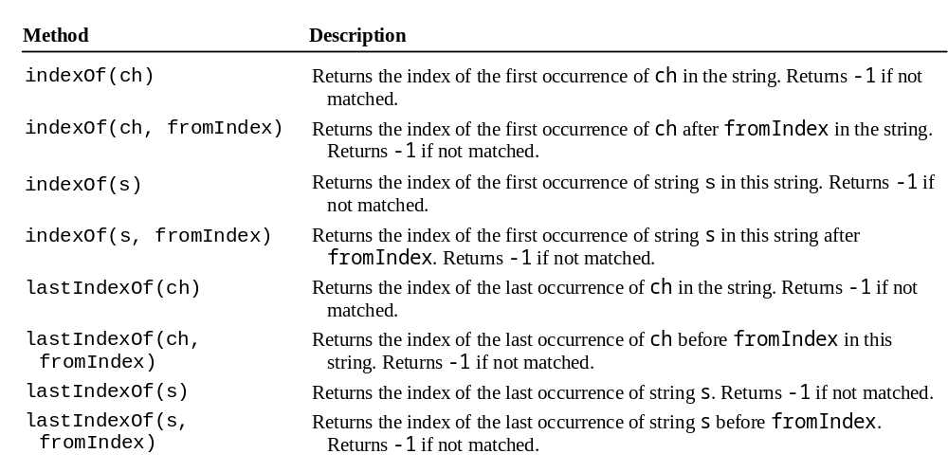
Finding a Character or a Substring in a String
System.out.println("abcdab".indexOf("ab")); //returns 0
System.out.println("abcdab".indexOf("ab", 2)); //returns 4
System.out.println("abcdab".lastIndexOf("ab")); //returns 4

Slide 23
Exercise
The program should ask the user to enter their first and last name which is then stored in a single string object. You should then break down this string into the first and last name and display them individually.

Slide 24
Conversion between Strings and Numbers
Use parseInt method available in Integer class to convert a string to a number
int a = Integer.parseInt(“35”);
double d = Double.parseDouble(“35.75”);
Converting from a number to a string – just add empty quotes to the number.
String s = number + "";

Slide 25
Formatting Output
Use the printf statement.
System.out.printf(format, item1, item2, …, itemk);
Where format is a string that may consist of substrings and format specifiers. A format specifier specifies how an item should be displayed. Each specifier begins with a percent sign. An item may be a numeric value, character, boolean value, or a string.

Slide 26
Frequently-Used Specifiers
Specifier Output Example
%b a boolean value true or false
%c a character 'a'
%d a decimal integer 200
%f a floating-point number 45.460000
%e a number in standard scientific notation 4.556000e+01
%s a string "Java is cool"

Slide 27
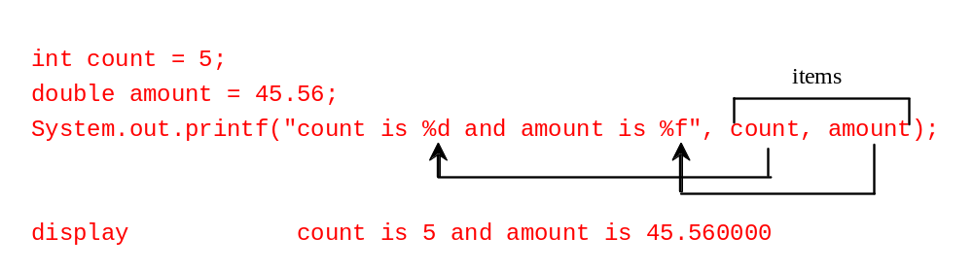
Frequently-Used Specifiers
In the previous example, amount is displayed as 45.560000.
You can limit the decimal digits to two points by using %.2f instead of %f.

Slide 28
Formatting Examples
System.out.printf("%3d#%2s#%4.2f\n", 1234, "Java", 51.6653);
Displays 1234#Java#51.67
The specified width for int item 1234 is 3, which is smaller than its actual size 4. The width is automatically increased to 4.
The specified width for string item Java is 2, which is smaller than its actual size 4. The width is automatically increased to 4.
The specified width for double item 51.6653 is 4, but it needs width 5 to display 51.67, so the width is automatically increased to 5.

Slide 29
Formatting Examples
You can display a number with comma separators by adding a comma in front of a number specifier. For example, the following code
System.out.printf("%,15.1f\n", 12345678.263);
Displays
12,345,678.3
Please note that the number requires 12 spaces, but we reserved 15 spaces, so there are 3 empty spaces at the start of the number.

Slide 30
Formatting Examples
You can pad a number with leading zeros rather than spaces by adding a 0 in front of a number specifier.
For example, the following code
System.out.printf("%,015.1f\n", 12345678.263);
displays 00012,345,678.3

Slide 31
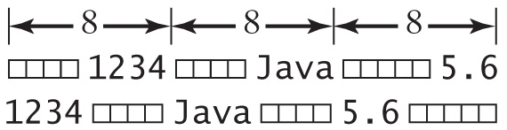
Formatting Examples
By default, the output is right justified. You can put the minus sign ( - ) in the format specifier to specify that the item is left justified in the output within the specified field.
System.out.printf("%8d%8s%8.1f\n", 1234, "Java", 5.63); System.out.printf("%-8d%-8s%-8.1f \n", 1234, "Java", 5.63);
displays

